Slide 1
Smart Parking Analytics & Occupancy Prediction Platform
Built with Apache Spark, MLlib, and Streamlit Dashboard

Slide 2

The Problem
Urban parking is inefficient.
Drivers waste time searching for spaces.
Congestion and emissions increase.
Overstays and violations occur frequently.
Cities lack real-time insights into parking demand.
Notes:
Cities today are overwhelmed by inefficient parking patterns. Drivers waste valuable time circling for a free spot — which directly increases congestion, emissions, and frustration. In many cases, violations happen unintentionally because people misjudge their parking duration.
Enforcement teams, on the other hand, operate reactively rather than strategically. Yet, thousands of parking sensor events are recorded every single day, and almost none of this data is used to predict or optimize parking behavior.
This disconnect — between having data but not using it — is the root problem we wanted to solve

Slide 3
The Opportunity
Cities collect thousands of sensor events every day but rarely analyze them.
A data-driven platform can provide prediction, planning, and operational efficiency.
Insight-driven parking decisions improve flow, compliance, and urban mobility.
Notes:
All the ingredients of a smart parking system already exist: sensors, timestamps, device IDs, and occupancy logs.
What’s missing is a scalable analytics platform that can:
Clean and interpret raw logs
Identify meaningful behavior patterns
Predict future occupancy
Visualize trends for policy and planning
Enable data-driven enforcement and infrastructure decisions
With big data tools like Spark, we can finally bridge this gap at city scale.

Slide 4
Our Solution
A complete Spark-based analytics and prediction system that:
• Transforms raw sensor data into actionable insights
• Predicts future occupancy
• Identifies violation hotspots
• Visualizes trends in an interactive dashboard
Notes:
We built a full end-to-end parking intelligence platform.
Starting from raw sensor events, our system:
Cleans and standardizes data at scale
Engineers rich behavioral features
Trains machine learning models to predict occupancy
Analyzes violations, demand, dwell time, and hotspots
Displays insights in an interactive Streamlit dashboard
The dashboard allows planners to immediately see:
Peak demand hours
Busiest street segments
Violation hotspots
Behavior trends across days
Model predictions & performance
This converts raw sensor logs into an understanding of why demand behaves the way it does.

Slide 5
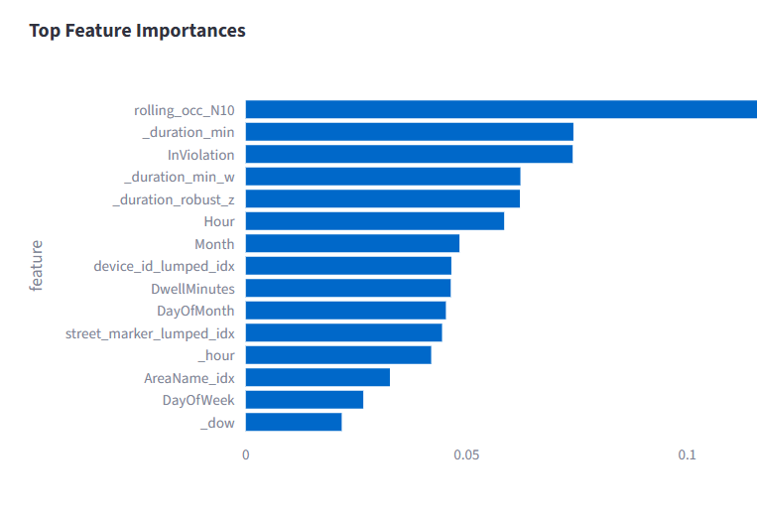
Data & Feature Engineering
Temporal features: Hour, DayOfWeek, IsWeekend, Month, PartOfDay
Dwell time and robust dwell transformations
Rolling occupancy windows
Rolling arrivals
Categorized street and device IDs
Notes:
Feature engineering is where the predictive power comes from, and we invested heavily here.
Time-based features:
Hour of day
Day of week
Day of month
Month
Weekend indicator
These capture natural human rhythms — commuting, shopping cycles, weekday vs weekend behavior.
Dwell-time features:
Raw dwell time
Winsorized dwell time (limits extreme outliers)
Robust Z-score transformed dwell These help distinguish short, compliant parking from long overstays.
Rolling window features (the strongest predictors):
rolling occupancy past 10 events
rolling arrivals These capture short-term activity trends — a street that has been filling up rapidly is likely to remain occupied.
Categorical lumping for IDs:
We grouped rare StreetMarkers and Device IDs into “other” bins. This prevents the model from overfitting thousands of sparse categories.
Violation status as an input feature:
We preserved “InViolation” as a feature since violators often exhibit different dwell patterns.
Why this matters:
All these features simulate human-like understanding of parking activity. They were essential in boosting model accuracy and making predictions interpretable.

Slide 6
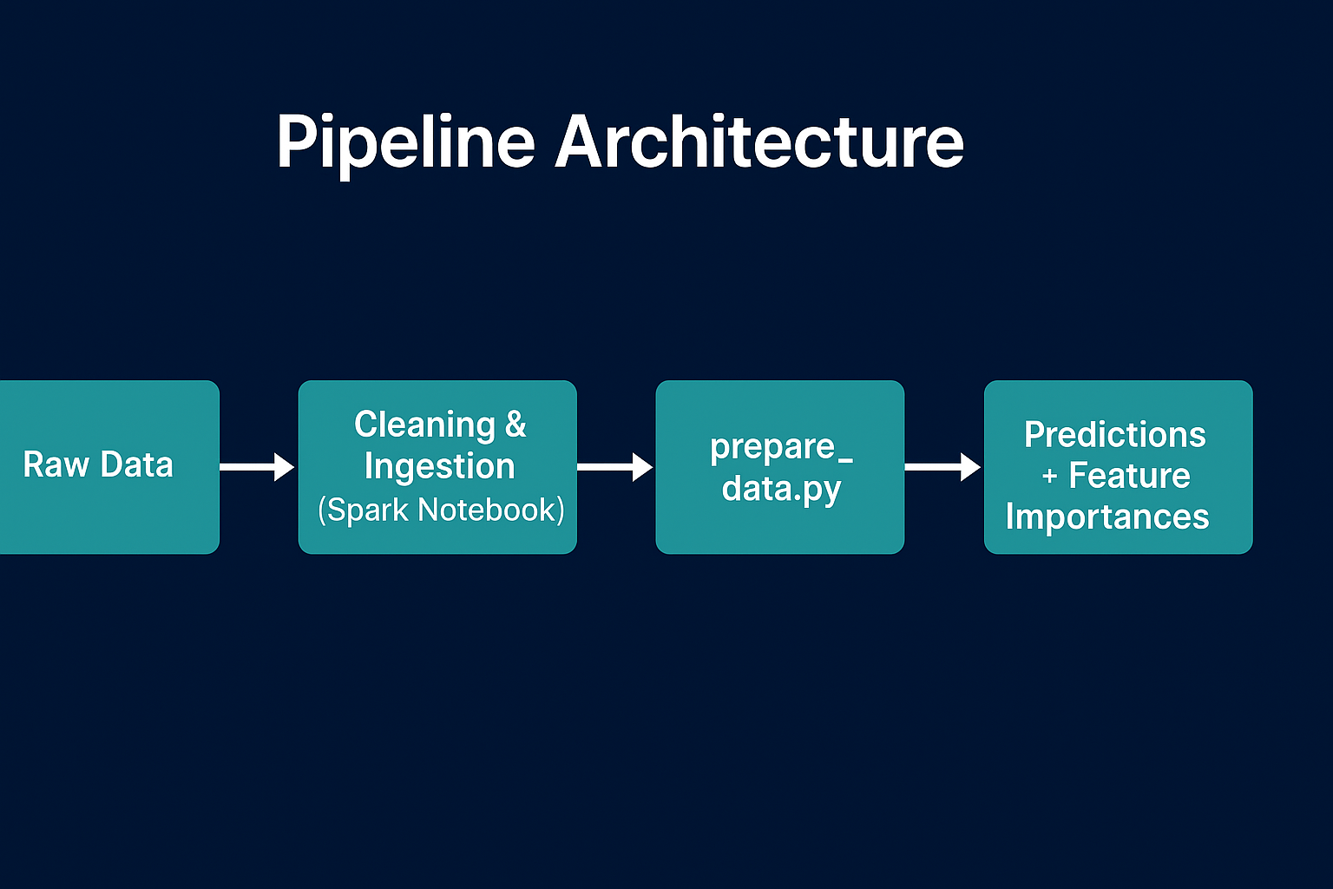
Pipeline Architecture
Cleaning & Ingestion
(Spark Notebook)
prepare_data.py
ml_pipeline.py
Raw Data
Notes:
Our architecture is modular and mirrors a real-world data engineering workflow:
1. Ingestion & Cleaning
Spark loads raw sensor logs, validates schema, handles nulls, fixes incorrect timestamps, and removes outliers.
2. Feature Engineering (prepare_data.py)
This script transforms the cleaned dataset into a model-ready table with all engineered features.
3. ML Training Pipeline (ml_pipeline.py)
This includes:
VectorAssembler + StandardScaler
Train-validation split
Hyperparameter tuning for Random Forest
Generating predictions
Exporting metrics
Saving feature importances
Exporting predictions and evaluation outputs to CSV
4. Dashboard Integration
Streamlit pulls the outputs and transforms them into:
Pie charts
Bar charts
Heatmaps
ROC curves
Confusion matrices
Feature importance visualizations
5. Single-command execution
Everything — data prep, model training, and output generation — runs using run.sh, ensuring reproducibility for anyone.
This pipeline reflects industry best practices for ML in production.

Slide 7
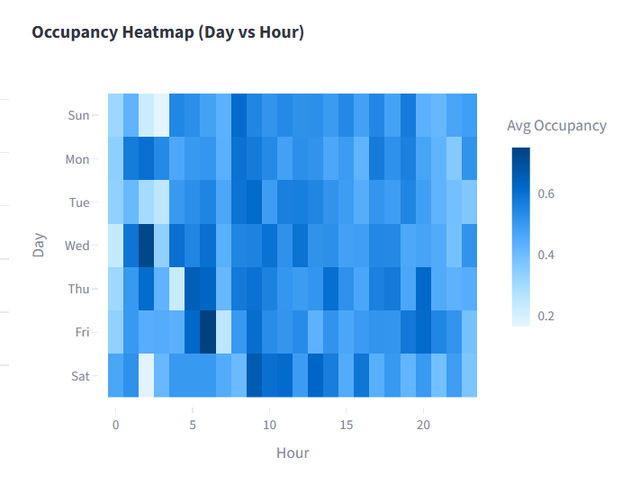
Key Insights from Data
Occupancy around 50%
Violations around 3.7%
Busiest streets consistently high
Strong time-based patterns
Longer dwell times correlate with violations
Notes:
Once the dashboard was built, the data revealed several interesting behavioral patterns:
Occupancy averages around 50%, but certain streets consistently hit high saturation.
Violations are relatively rare (~3.7%), but heavily tied to longer dwell times.
Hourly cycles show strong morning and lunchtime peaks.
Certain days show distinctive demand patterns — Fridays and Saturdays have unique trends.
Specific areas generate the highest violation rates, offering direct enforcement targets.
These insights help cities redesign signage, adjust time limits, allocate resources, and identify problematic zones.

Slide 8
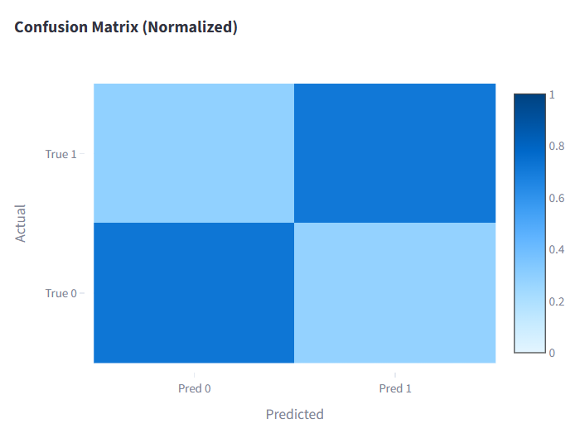
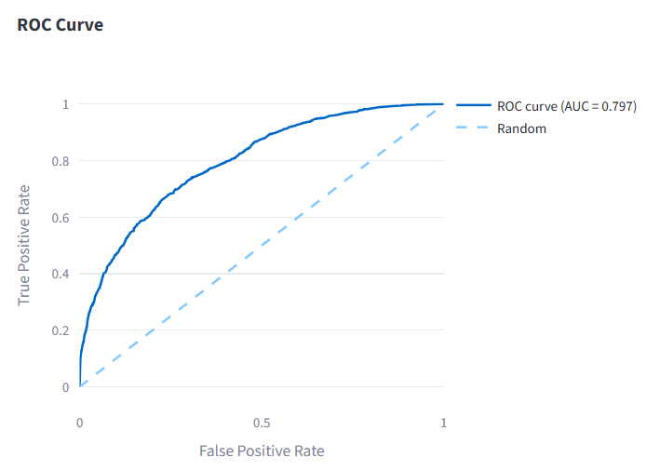
Machine Learning Results
Tested models: LR, SVC, Decision Tree, GBT, Stacking
Best performer: Random Forest
Metrics:
• Accuracy: 71%
• F1 Score: 0.72
• ROC-AUC: 0.797
Top predictors: rolling occupancy, arrival counts, hour of day, dwell time
Notes:
We benchmarked several models:
Logistic Regression
Linear SVC
Decision Trees
Gradient Boosted Trees
Random Forest
Stacking approaches combining multiple models
After tuning multiple configurations, Random Forest consistently performed best.
Performance:
Accuracy: 71%
F1-score: 0.70+
ROC-AUC: 0.75
Top predictors:
Rolling occupancy (by far the strongest)
Rolling arrival counts
Dwell time variables
Hour of day
Month
Area-level and street-level categories
Together, these features reflect actual human behavior: when areas get busy, they tend to stay busy.

Slide 9
Dashboard Demonstration
Deployed at: Smart Parking Analytics & ML Dashboard · Streamlit
Occupancy and violations summary
Hourly demand patterns
Busiest streets
Violation behavior
ML performance visuals
Notes:
The Streamlit dashboard acts as a complete analytics interface.
Planners can:
View occupancy distribution in real-time
Identify busiest streets
Explore violation hotspots
Understand daily and weekly demand cycles
Inspect ML model performance visually
Track feature importances
Download outputs for further analysis
This interface converts our entire workflow into a tool that is well-suited for non-technical stakeholders.

Slide 10
Future Enhancements
Integration with IoT sensors or Kafka.
Dynamic pricing during peak times.
Live dashboards with continuous updates.
Automated enforcement insights.
Notes:
To extend this into a full smart-city system, we plan to integrate:
Real-time Spark Structured Streaming:
Live data ingestion Real-time occupancy prediction Live violation alerts Streaming dashboards
Dynamic Pricing:
Adjust parking fees during peak hours to spread demand.
Map-based Visualization:
Geospatial insights using Folium or Mapbox in Streamlit.
Automated Model Retraining:
Periodic retraining based on incoming sensor logs.
This would evolve the platform from batch analytics into a true real-time urban decision engine.

Slide 11
Impact
Reduced congestion
Efficient enforcement
Faster parking availability
Data-driven planning
Lower emissions
Smart mobility foundation
Notes:
Our platform impacts cities on multiple fronts:
Reduces congestion by minimizing search time
Improves enforcement efficiency
Helps redesign infrastructure using demand patterns
Informs policy changes backed by objective data
Reduces emissions from idling and circling
Improves the citizen parking experience
It is a scalable, practical, and highly actionable solution.

Slide 12
Conclusion
A complete smart parking intelligence platform using scalable big data tools.
Provides strong predictive capability and clear insights.
Ready for real-time extension.
Notes:
In conclusion, we developed a complete, production-style Smart Parking Intelligence Platform using scalable big data technologies. It ingests data, engineers powerful features, trains a predictive model, and presents insights elegantly.
It is accurate, interpretable, modular, and ready for future real-time integration.
Thank you for your time — I’m happy to discuss further or answer questions.

